Slide 1

Music Recommender System
Under esteemed guidance of
Himanshu Goswami
Team 10
Vinod Nayak
Akshat Kabra
Shaik Haneef
Ashish Kumar Singh
Narender Annam

Slide 2
What is Recommender System ?
A recommender system is a type of information filtering system. By drawing from huge data sets, the system’s algorithm can pinpoint accurate user preferences. Once you know what your users like, you can recommend them new, relevant content. And that’s true for everything from movies and music, to romantic partners.
Netflix, YouTube, Tinder, and Amazon are all examples of recommender systems in use. The systems entice users with relevant suggestions based on the choices they make.

Slide 3
Recommender systems are broadly classified into personalized and non-personalized recommender systems.
As it is evident from the name itself, a non-personalized recommender system is a generic recommender system which provides recommendations based on the opinions and feedbacks of the other users.
An example of such a system would be any retail website such as Amazon or Macy’s which shows a list of products as recommended items for purchase when you land on their home page (without logging in)
A personalized recommendation system on the other hand maintains a user profile and tries to match the items with the taste profile of a user before presenting them as a recommendation to the user.
A prime example of such a recommender system would be Netflix, which presents a list of different recommendations to each user based on their taste.

Slide 4
Applicable areas
E-COMMERCE
BANKING
TELECOM
RETAIL
SEARCH ENGINE AUTOMATION
SOCIAL NETWORKING
ENTERTAINMENT
UTILITIES
& many more…

Slide 5
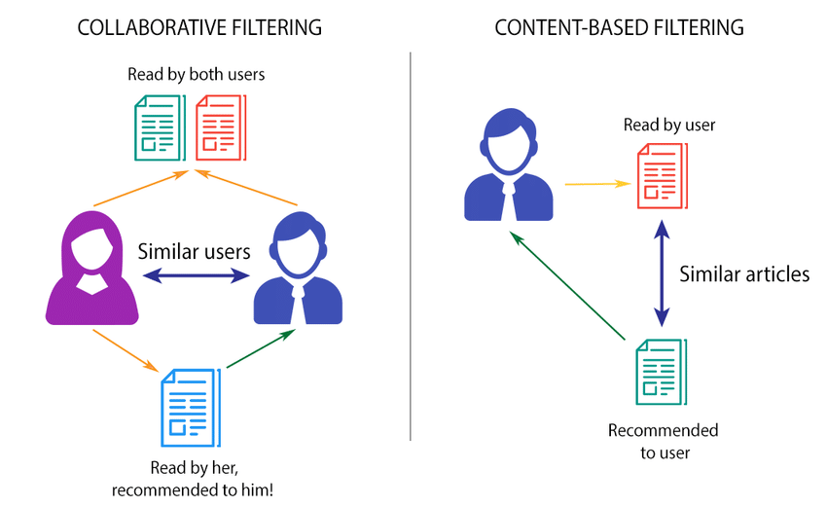
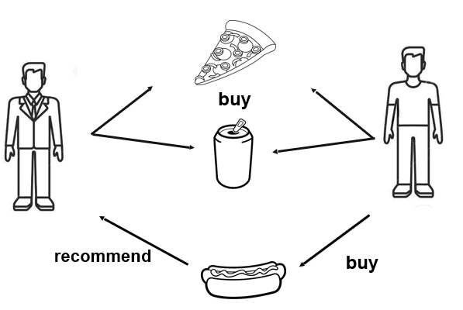
Collaborative Filtering
It uses the users’ historical preference on a set of items. Because it’s based on historical data, the core assumption here is that the users who have agreed in the past tend to also agree in the future.

Slide 6
Content-Based Filtering
The basic idea of content-based filtering is to map relevant content based on certain features or characteristics.
Characteristic information includes:
Characteristics of Items (Keywords and Attributes)
Characteristics of Users (Profile Information)
Content here refers to the content or attributes of the products you like. So, the idea in content-based filtering is to tag products using certain keywords, understand what the user likes, look up those keywords in the database and recommend different products with same attributes.

Slide 7
Lets take an example of an online book store.
In this case, the name of the author is one of the features. The other features can be the genre of the book, price, the number of pages, etc.
To solve this problem, each item is described through an item vector. Thus, if there are n attributes that can be used to describe any item set, the item vector for an item will be a vector of size n having 0 or 1 corresponding to each characteristic. Similarly, the taste and preferences of a user is represented by a user vector where rating points are assigned corresponding to each characteristic.
The dot product of the two vectors depicts the compatibility of the item with the user. The higher the value of this dot product, the more is the chance of the user liking the particular product.

Slide 8
Cold Start Problem
What is the Cold Start Problem ?
With recommendation engines, the “cold start” simply means that the circumstances are not yet optimal for the engine to provide the best possible results. In eCommerce, there are two distinct categories of cold start: product cold start and user cold starts.
Problems
User or Visitor Cold start : New Users
Item or Product Cold start : New Items
System Cold start : New System

Slide 9
User Or Visitor Cold Start
The user or visitor cold start simply means that a recommendation engine meets a new visitor for the first time. because there is no user history about user, the system doesn’t know the personal preferences of the user. Getting to know your visitors is crucial in creating a great user experience for them.
Item Or Product Cold Start
A new item is added to the system, it might have some content information but no interactions are present
System Cold Start
The new community problem, or system cold start , refers to the startup of the system, when virtually no information the recommender can rely upon is present. This case presents the disadvantages of both the New user and the New item case, as all items and users are new. Due to this some of the techniques developed to deal with those two cases are not applicable to the system bootstrapping

Slide 10
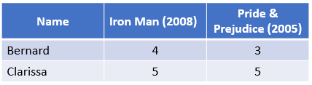
How cosine similarity works?
Cosine similarity is a method to measure the difference between two non zero vectors of an inner product space. See the example below to understand.
Suppose I want to check if Bernard and Clarissa have similar movie preferences, and I only have two movie reviews. The reviews are scores from 1 to 5, where 5 is the best score and 1 the worst, and 0 means that a person has not watched the movie

Slide 11

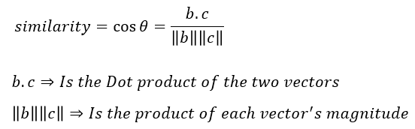
I can represent each person’s reviews in a separate vector.
The cosine similarity will measure the similarity between these two vectors which is a measurement of how similar are the preferences between these two people.

Slide 12
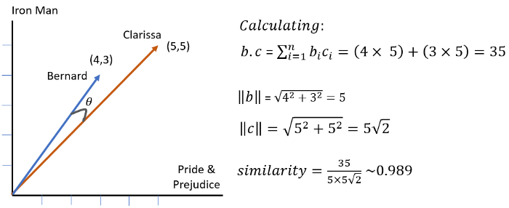
In the example above the similarity 0.989 is close to the maximum value of 1, this means that given only two movie reviews the two users have similar preferences.
Theoretically, the cosine similarity can be any number between -1 and +1 because of the image of the cosine function, but in this case, there will not be any negative movie rating so the angle θ will be between 0º and 90º bounding the cosine similarity between 0 and 1. If the angle θ = 0º =>cosine similarity = 1, if θ = 90º => cosine similarity =0.

Slide 13
Team 10
Vinod Nayak
ID: IN30032
E-Mail ID: vinodknayak10@gmail.com
Akshat Kabra
ID: IN30109
E-Mail ID: kabraakshat20@gmail.com
Shaik Haneef
ID: IN30170
E-Mail ID: shaikhaneef42@gmail.com
Ashish Kumar Singh
ID: IN30180
E-Mail ID: ashishsingh070809@gmail.com
Narender Annam
ID: IN30211
E-Mail ID: NarenderAnnam@outlook.com

Slide 14
Thank You!

